Slide 1

Week 13 –
Introduction to Causal Inference in Data Visualization
Visual Techniques for Understanding Causality: Basics

Slide 2
Contents
What Is Causal Inference?
Case Study
Methods for Causal Inference in Data Visualization
Importance of Causal Inference in Data Visualization
Types of Causal Relationships
Visual Techniques for Understanding Causality
Practical Demonstration Snippets
Common Pitfalls in Causal Inference
Examples of Effective Data Visualizations Using Causal Inference

Slide 3
What Is Causal Inference?
Causal inference is the process of determining cause-and-effect relationships between variables
Correlation is not causation
1
Correlation vs Causation
2
Why It Matters
Correlation identifies a relationship between two variables. Causation is when one variable causes an outcome in the other.
Causal inference allows us to go beyond identifying correlations in data and pinpoint the exact variables responsible for different outcomes, making data-driven decision-making more accurate and effective.

Slide 4

Case Study
Smoking and Lung Cancer
A classic case study of correlational evidence turned on its head by looking at causation.
Identify Variables: Smoking & Lung Cancer
1
Observe Data: Collect data on smoking habits and lung cancer rates
2
Check for Correlations: Higher lung cancer rates among smokers
3
Control for Confounders: Exclude other potential causes
4
Establish Causality: Determine smoking as a primary cause
5
Visualize & Interpret: Use graphs to represent data
6

Slide 5
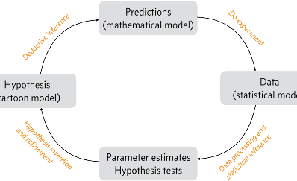
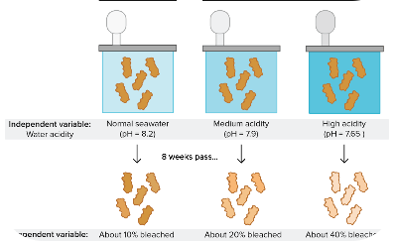

Methods for Causal Inference in Data Visualization
Statistical Models
Controlled Experiments
Machine Learning
Statistical models help establish causal relationships by controlling for extraneous variables and identifying confounding factors and other data biases.
Randomized experiments are ideal for causal inference since they allow for the manipulation of variables to determine cause-and-effect relationships.
Machine learning tools are used in causal inference by analyzing large amounts of data and identifying patterns and relationships between variables.

Slide 6
Importance of Causal Inference in Data Visualization
Beyond Correlation
Informed Decision making
Clarity in Complex Systems
Facilitating Predictive Modeling
Highlighting Confounders

Slide 7
Types of Causal Relationships
Negative Causation
An increase in the value of one variable leads to a decrease in the value of the other.
1
2
3
Positive Causation
Spurious Correlation
An increase in the value of one variable leads to an increase in the value of the other.
When two variables show a strong correlation, but there is no causal link.

Slide 8
Visual Techniques for Understanding Causality
Visual techniques help us conceptualize and understand complex causal relationships in a more natural and effortless way.
1
Confounding
Confounding occurs when an external factor (the confounder) affects both the independent variable (cause) and the dependent variable (effect), leading to a spurious association between them.
2
Causal Graphs
Causal graphs are diagrams that depict variables as nodes and causal relationships as directed edges (arrows)
between them.
3
Probability Distributions
DAGs can represent joint probability distributions over the variables they include

Slide 9
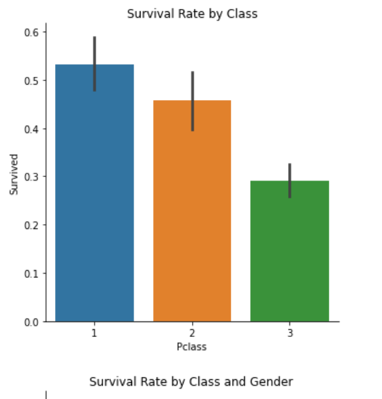
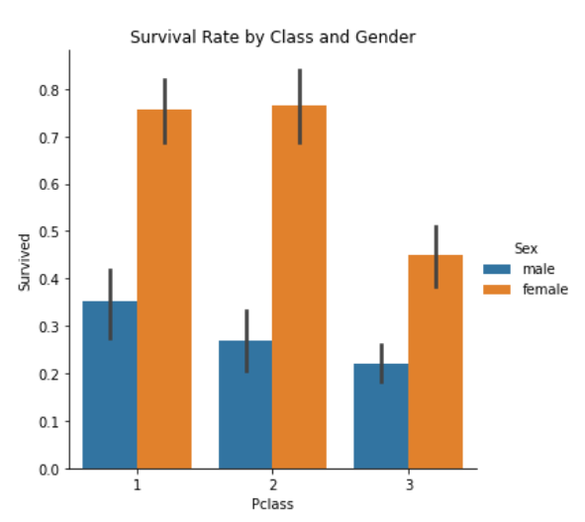
Output
Plots showcasing survival rates by class and gender

Slide 10
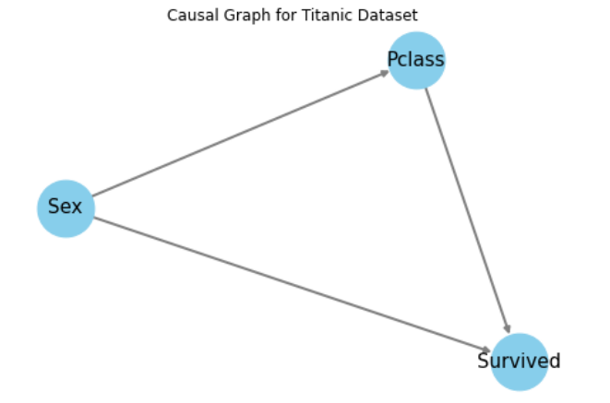
Output
Direct Acyclic Graph for titanic Dataset

Slide 11
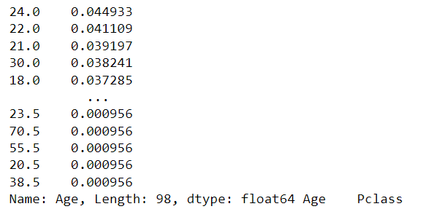
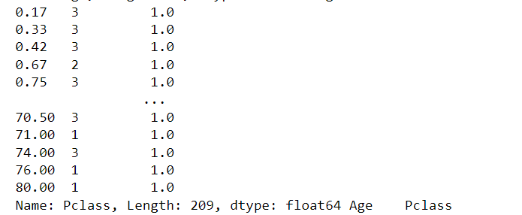
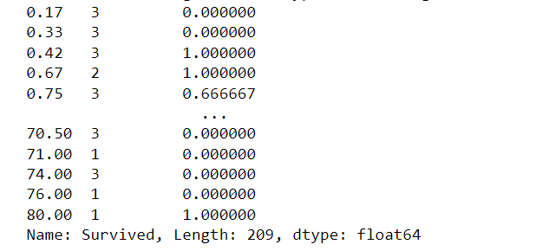
Output
Probability Distributions by P(Age)
Probability Distributions by P(Pclass/ Age)
Probability Distributions by P(Survived/Pclass/Age)

Slide 12
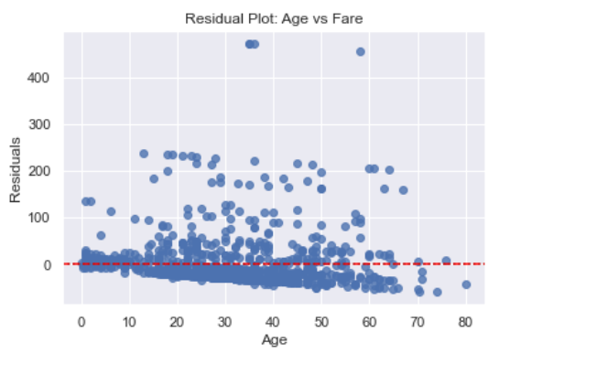
Output
Residual Plot between Fare and Age

Slide 13
Common Pitfalls in Causal Inference
Sampling Bias
Confounding Variables
When data samples are not representative of the population being studied. This can lead to misleading conclusions and inaccurate causal relationships.
Variables not directly accounted for in the analysis can create a spurious relationship or mask the true causal effect.
Reverse Causality
Overfitting
Mistaking the effect for the cause, leading to misleading conclusions.
Statistics used to generate a model can be too specific to that data set, leading to misleading conclusions and inaccurate causal relationships.

Slide 14


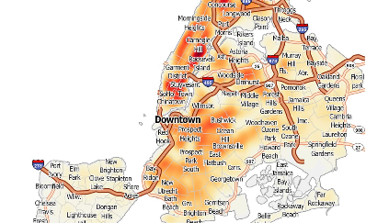
Examples of Effective Data Visualizations Using Causal Inference
Before-and-After Comparisons
Scatterplots
Mapping
Visualizing the relationship between two variables, such as the number of cups of coffee consumed and productivity.
Geographical visualizations that allow us to identify the relationship between location and outcomes like crime rates.
Visual representations of how outcomes changed due to a change in one variable, such as weight loss.

Slide 15
Thank You

